Slide 1
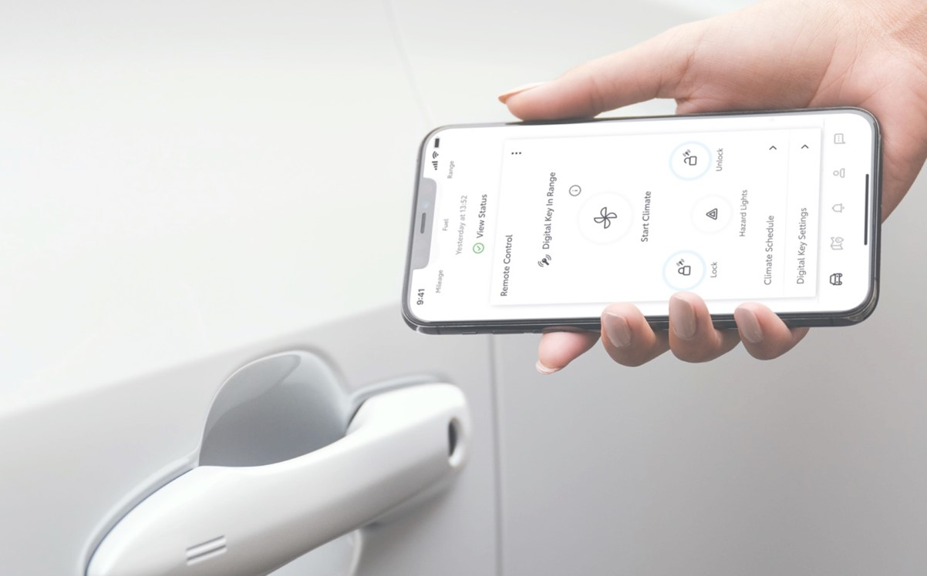
Lexus digital Key
Invited driver guide
Sharing digitaL key with friends and family
Lexus connected services
05/06/24

Slide 2
Content
01
Page 3 – Setting up your account
02
Page 10 – Using your Digital Key.
03
Page 11 – Managing and sharing your Digital Key.

Slide 3

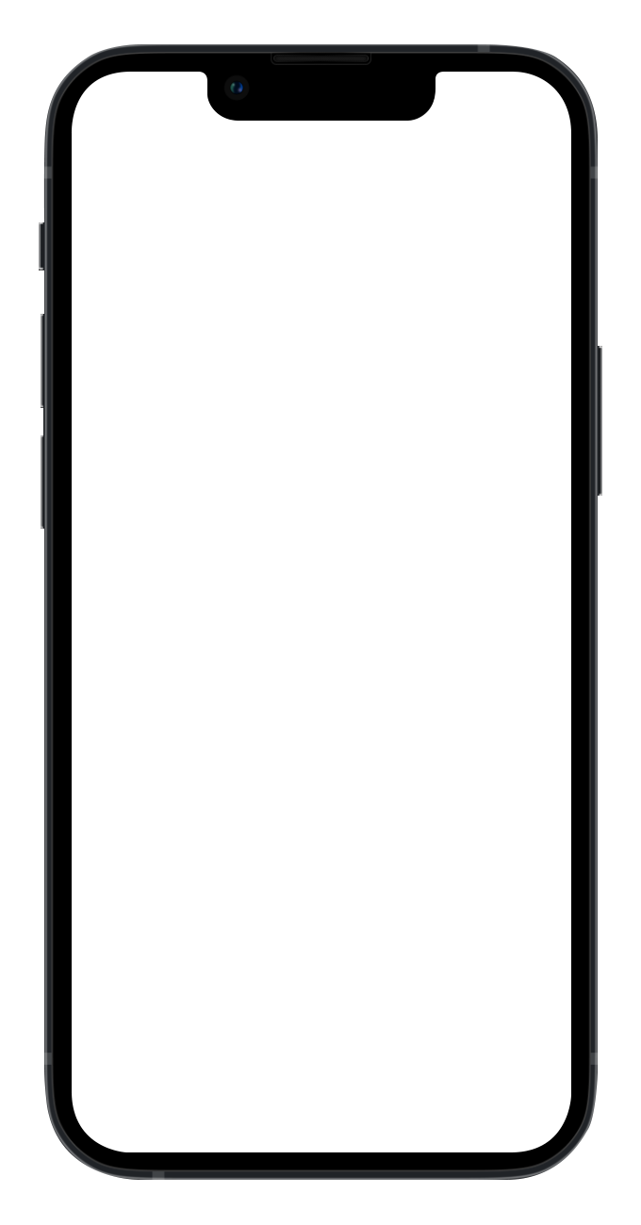
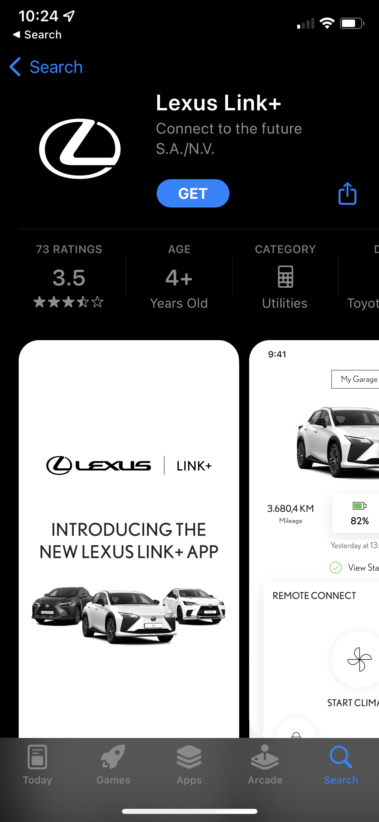
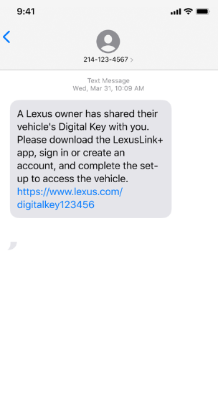

STEP 1
Having been invited to share a Digital Key, you will receive a text message.
If you haven't installed the Lexus Link+ App yet, click the link to download it
STEP 2
Download the app

Slide 4
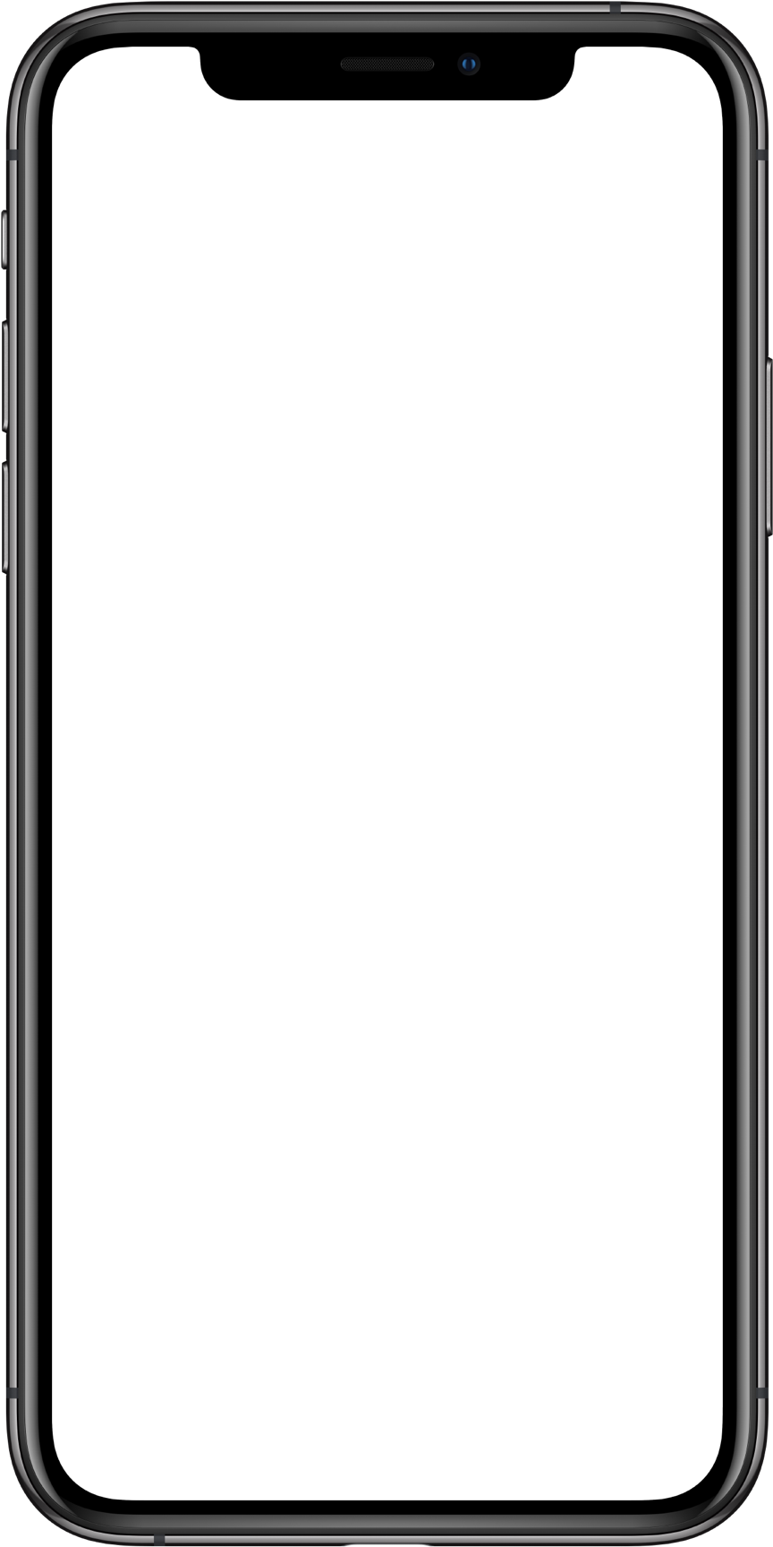
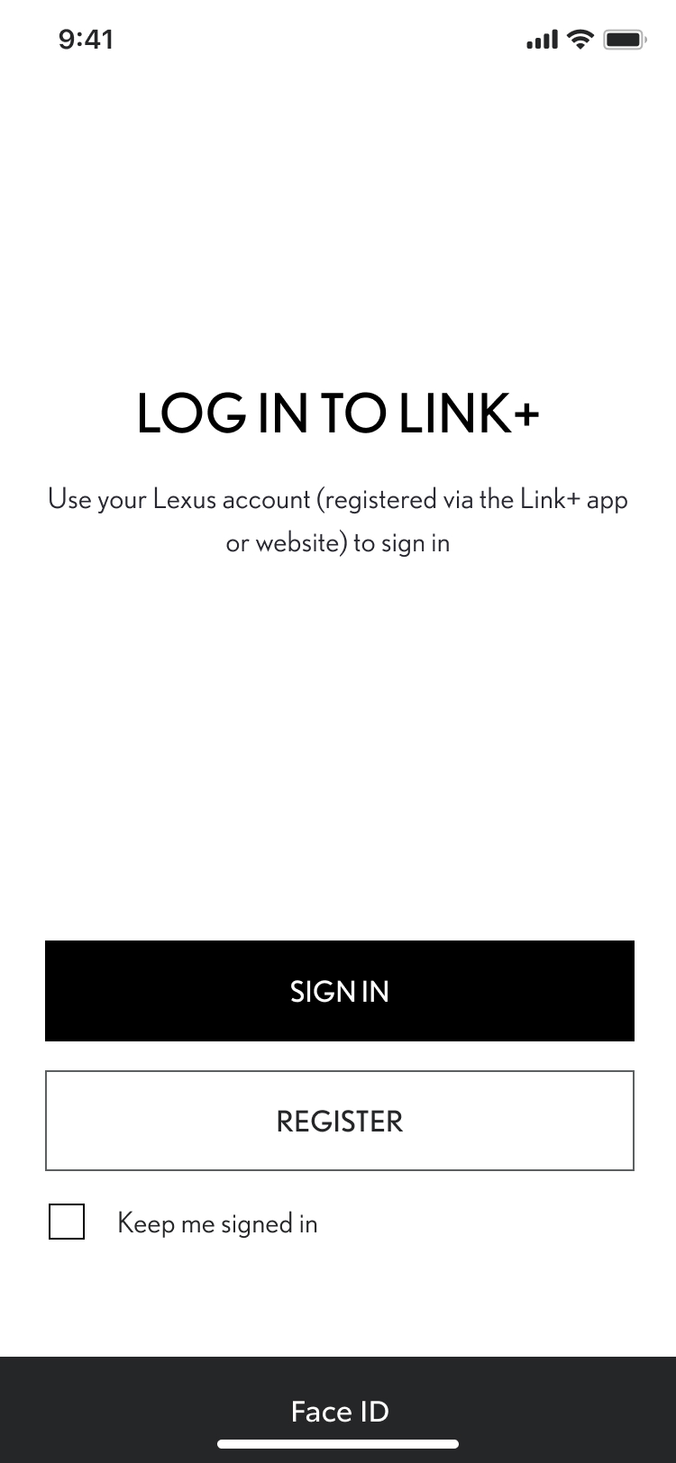
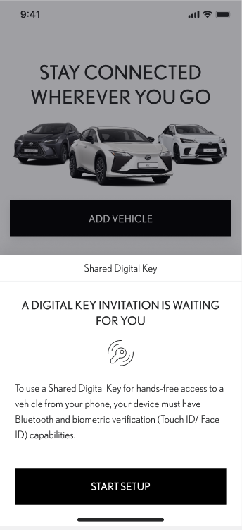
Setting up your digital key
STEP 1
Register your Lexus Link+ app account
STEP 2
Tap “Start Setup”

Slide 5
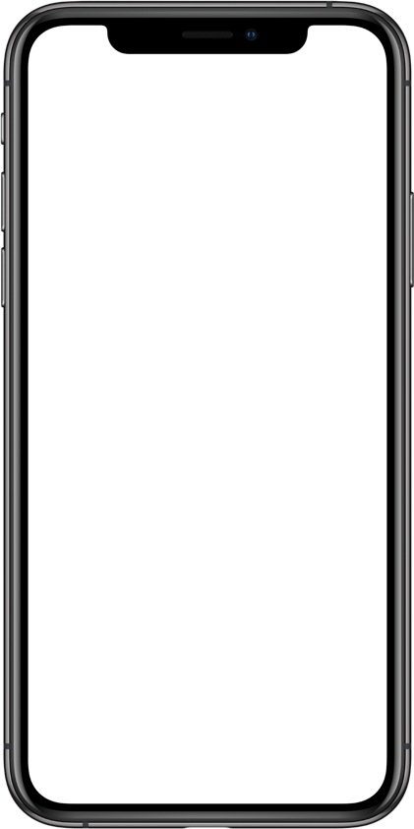
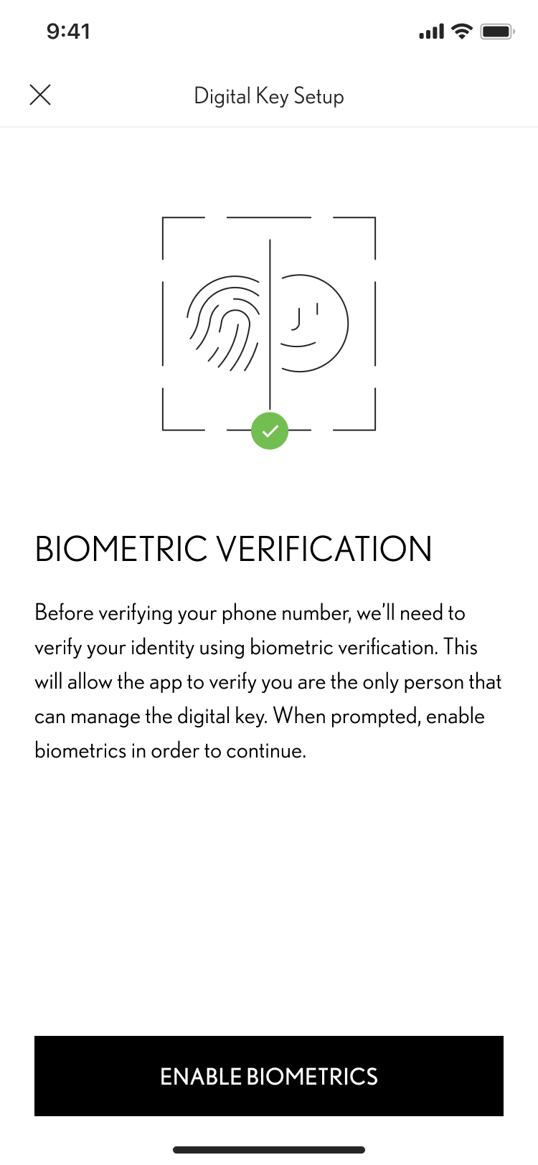
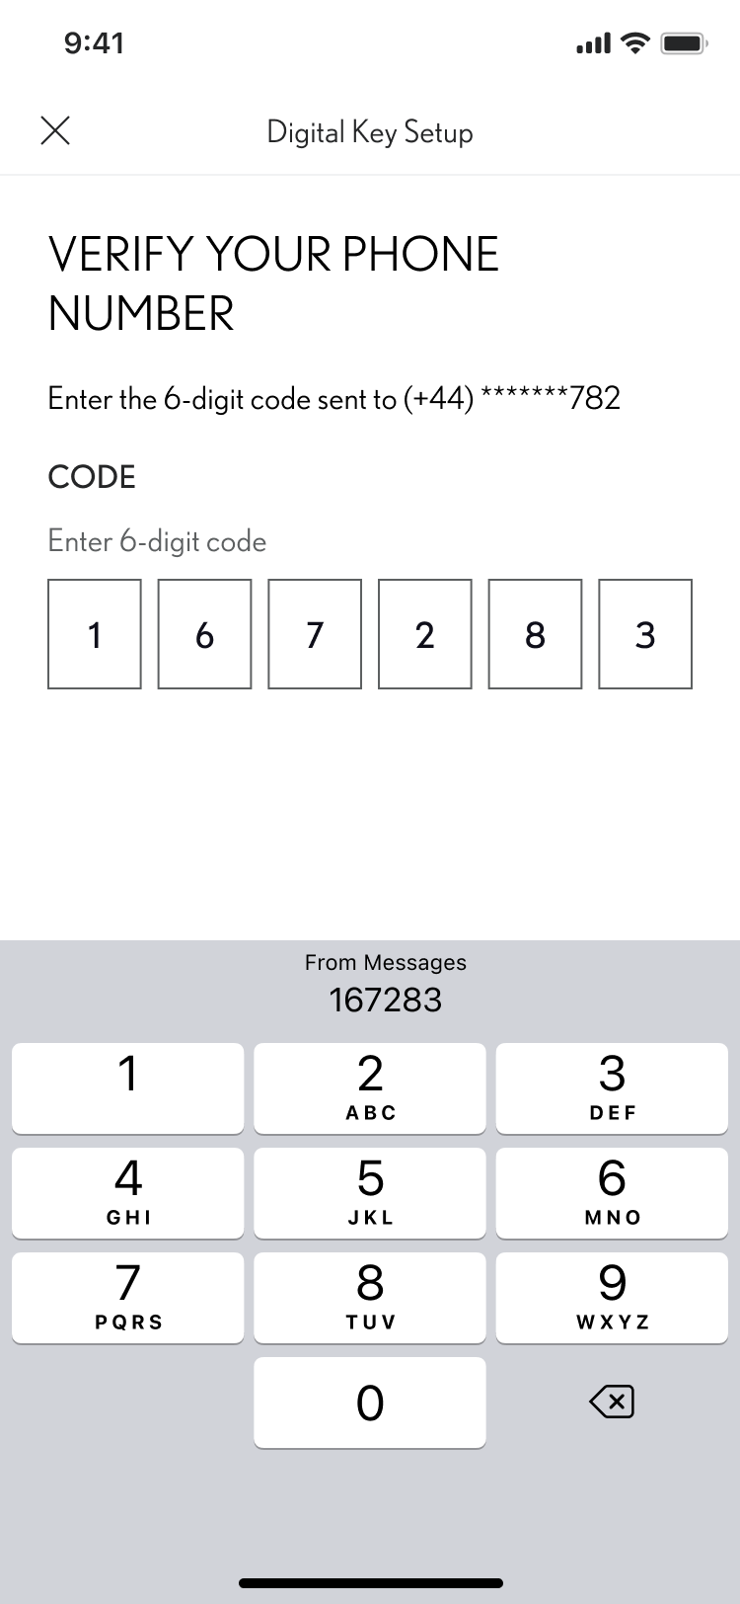
Setting up your digital key
STEP 3
Follow the setup screens to verify your phone number, then accept the invitation .
Ensure that you have a reliable WiFi or data connection and enable Bluetooth and Biometrics.
STEP 4
Verify your phone number.

Slide 6
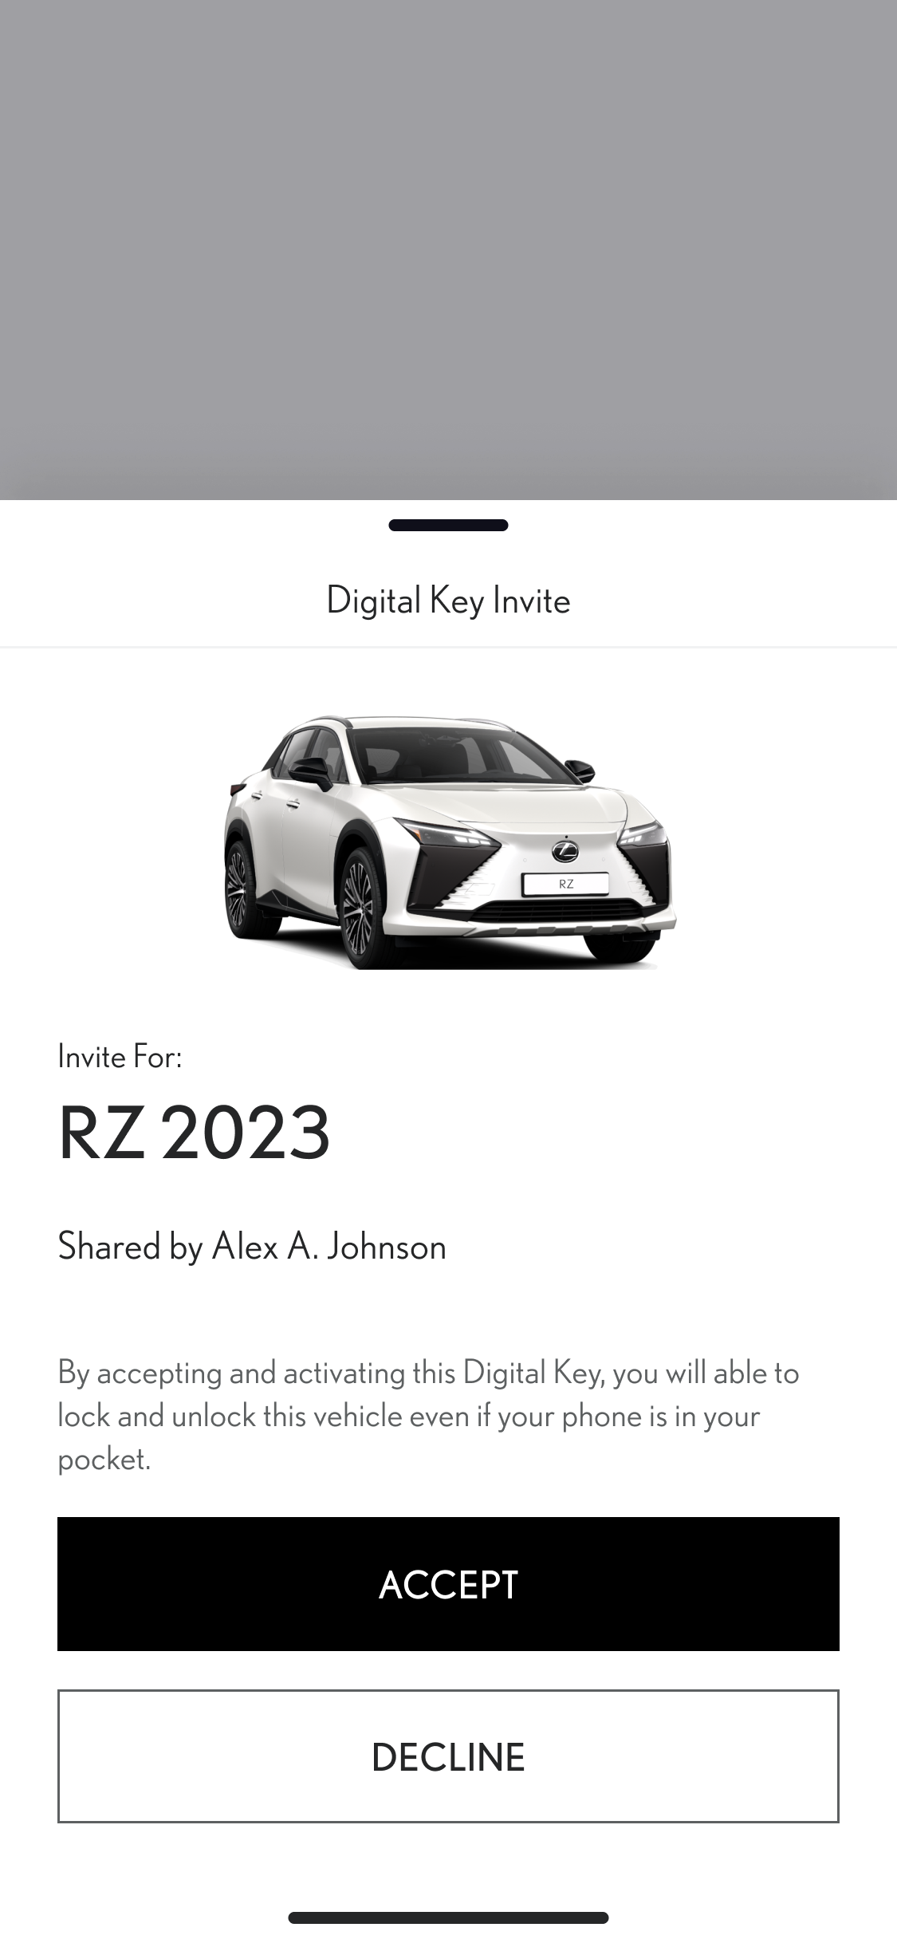
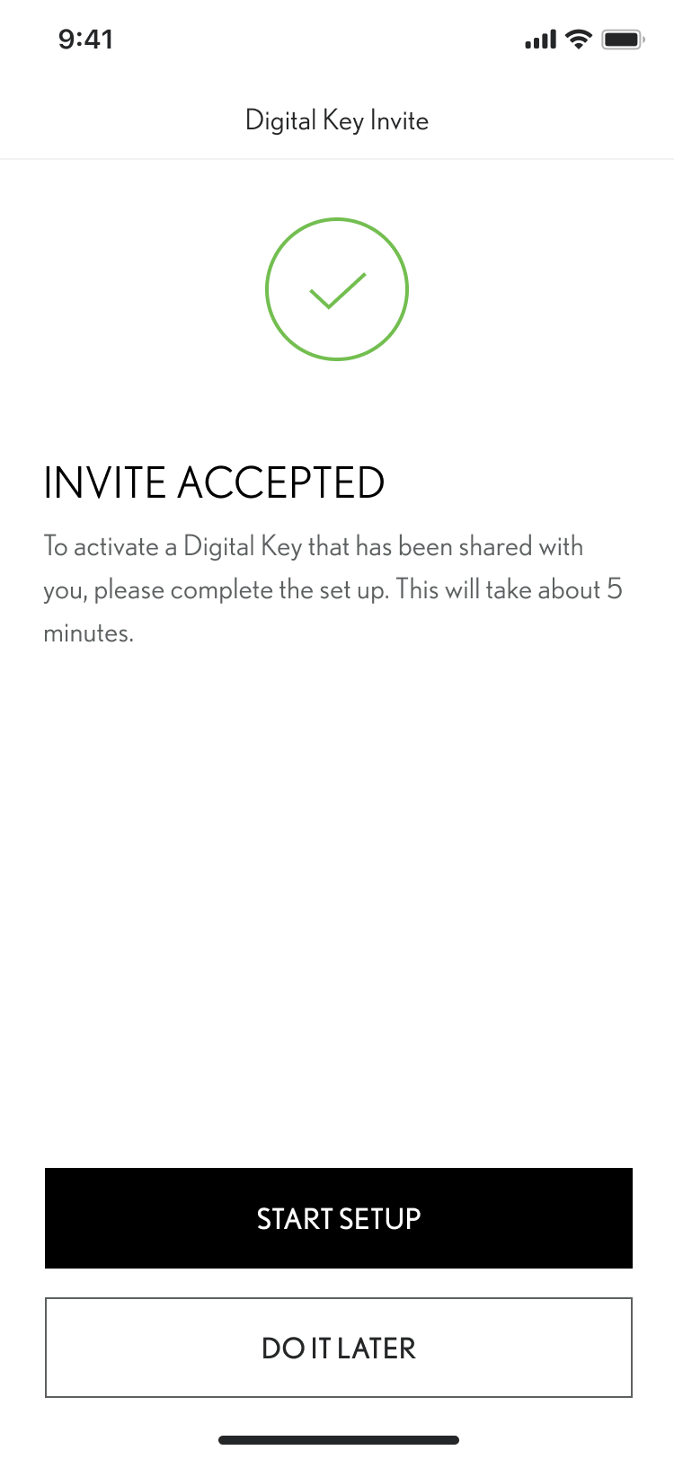

Setting up your digital key
STEP 5
To proceed in downloading a shared Digital Key, tap “Accept”.
STEP 6
To activate Digital Key, tap ‘Start Setup”

Slide 7
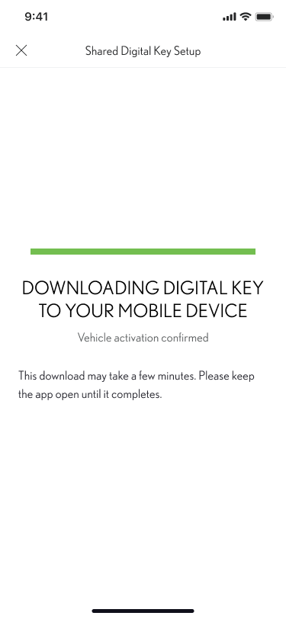
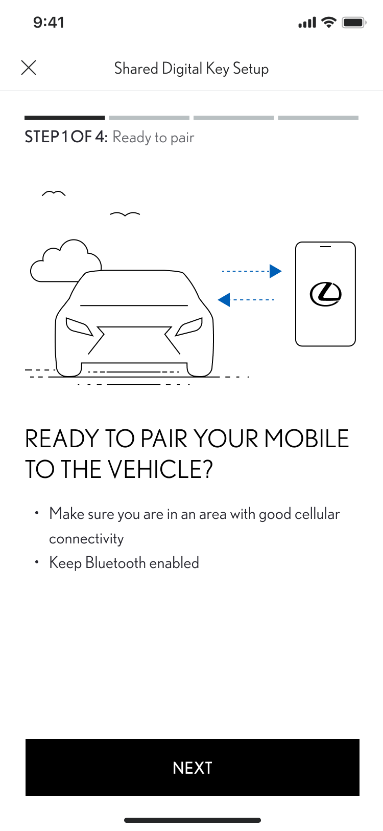
Setting up your digital key
STEP 7
The Digital Key downloads automatically.
STEP 8
To pair the phone with your vehicle, follow the screens.
Click “Next”.

Slide 8
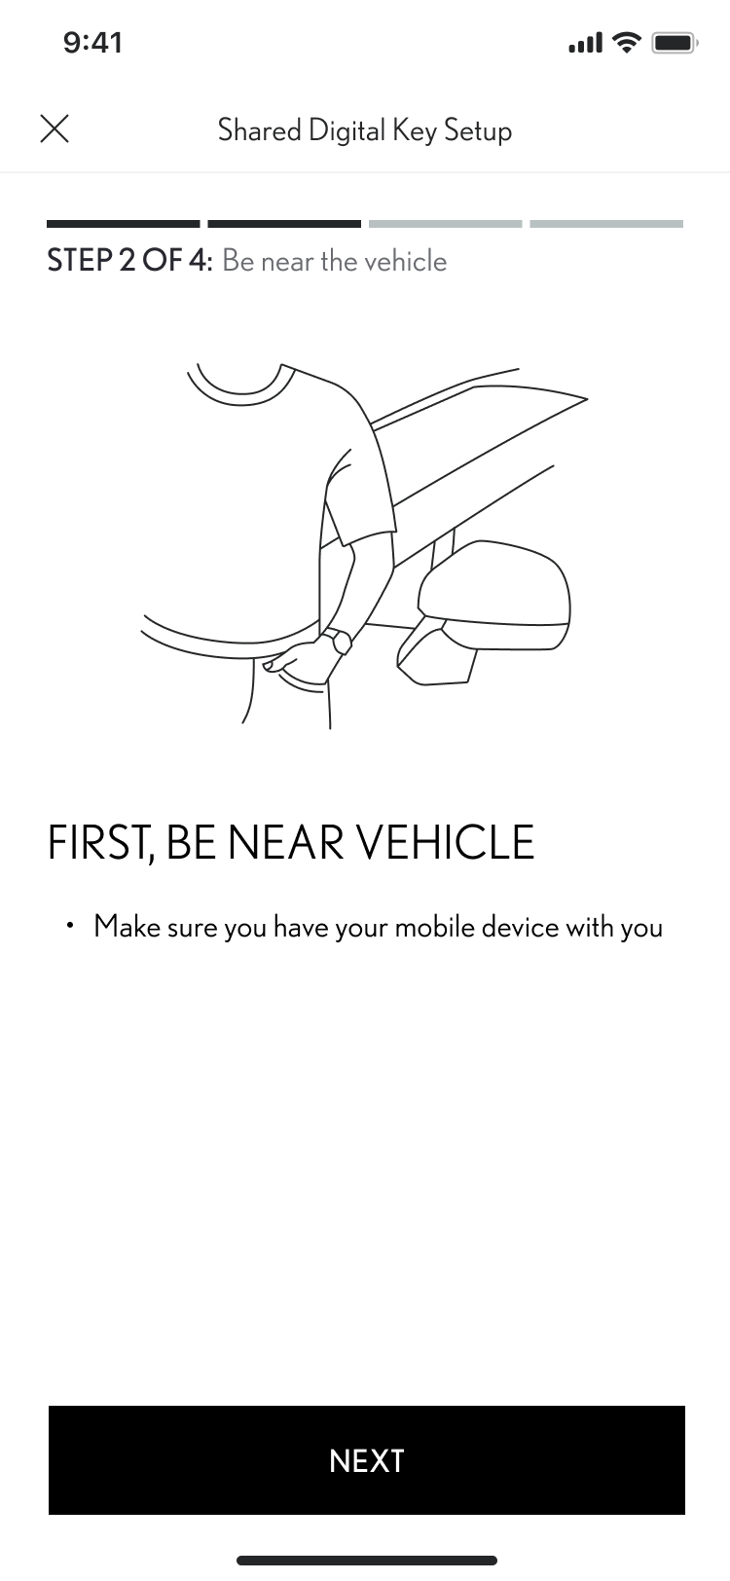
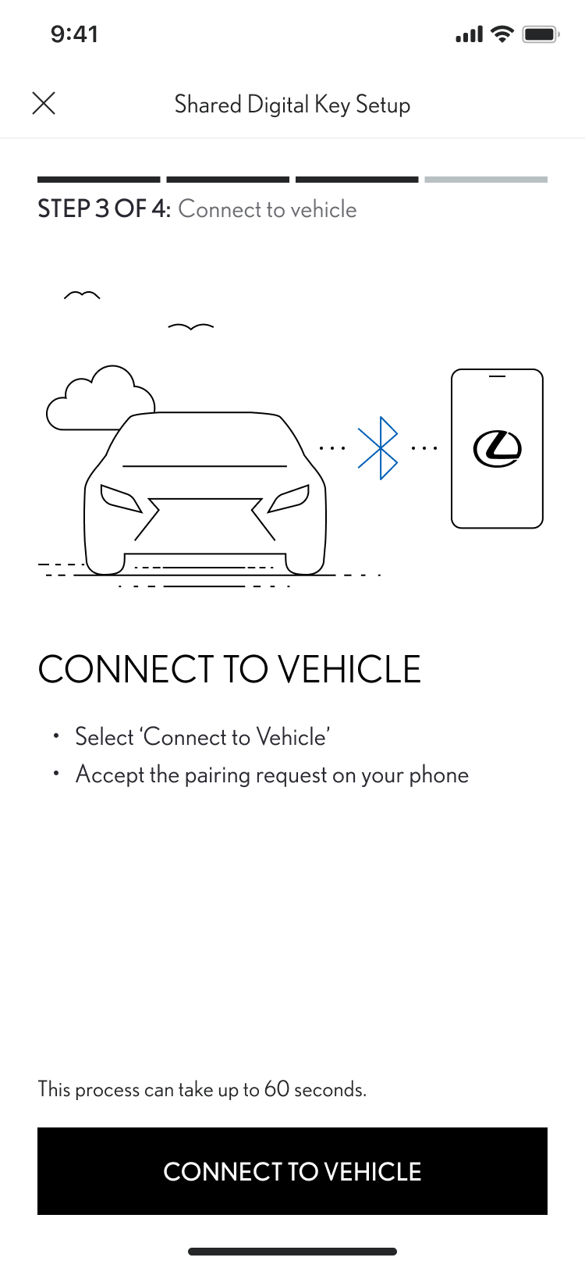
Setting up your digital key
STEP 9
Stay close to the vehicle and click “Next”.
STEP 10
Tap “Connect to Vehicle”.

Slide 9
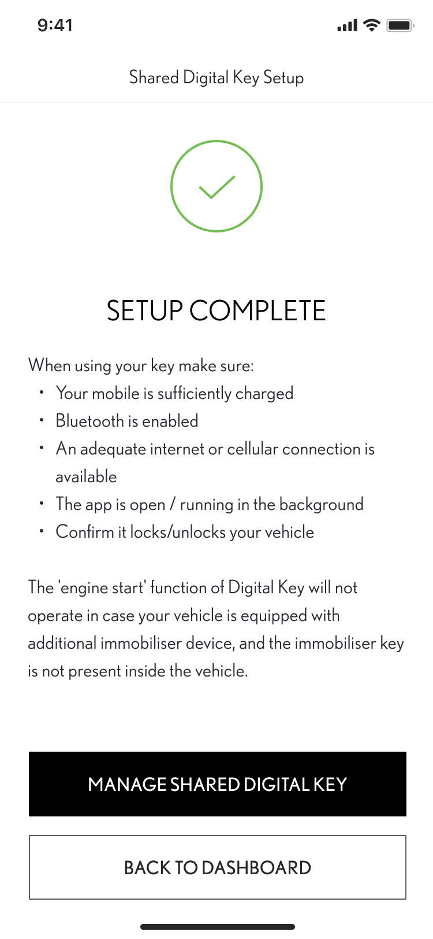
Setting up your digital key
STEP 11
Set-up is now complete.

Slide 10
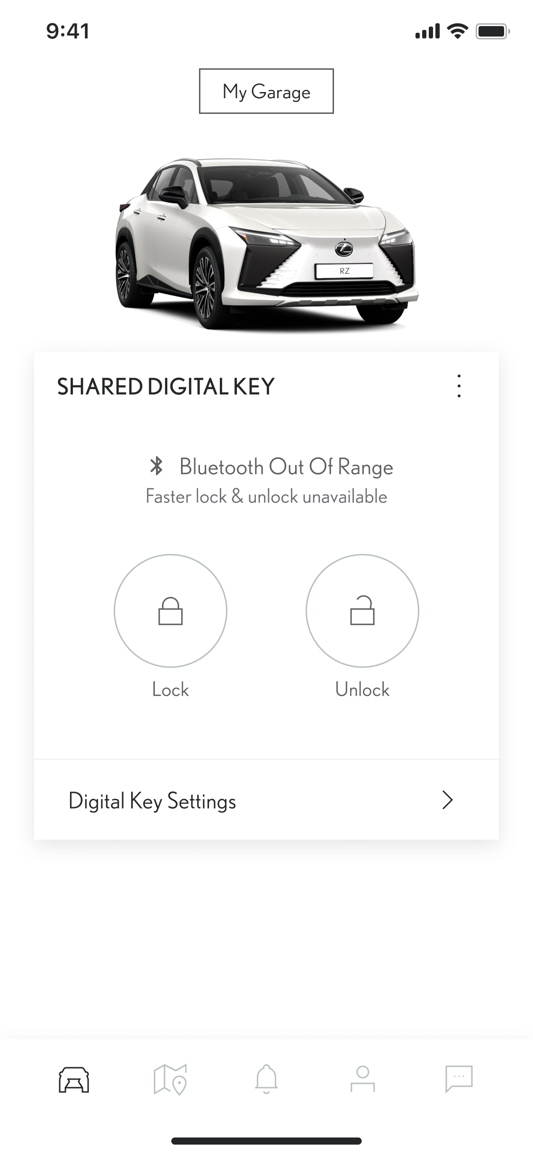
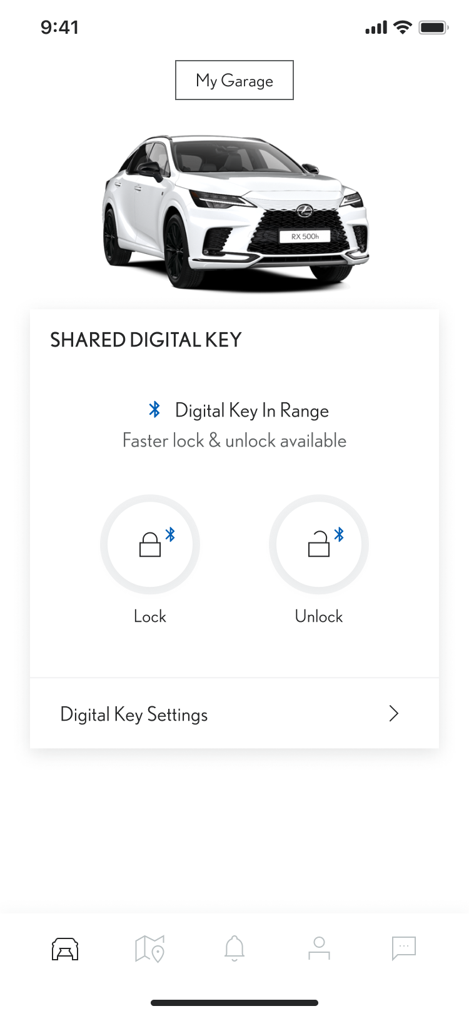
Using Your digital key
STEP 1
While using the app, the Bluetooth logo will indicate when the Digital Key is in range.
Here the screen shows the Digital key is out of range.
STEP 2
And here the Digital Key is in range.
*Because of some limits with the car’s antenna and signal strength, some functionalities might not always work as expected. This can include unlocking, locking, and starting the car, especially if there are obstacles blocking the way

Slide 11
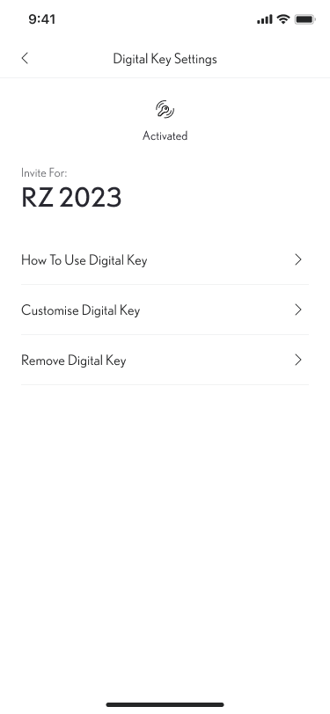
managing Your digital key
STEP 1
To manage or remove your shared Digital Key, simply go to the Digital Key Settings screen.
Tap on “Digital Key Settings”.
STEP 2
In this section, more information is available on how to use or remove the Digital Key.
Note: The engine start function of the Smart Digital Key will not operate if your vehicle is equipped with an additional immobiliser device, and if the immobiliser key is not present inside the vehicle (same as the physical key).
*Connected Services are continually improving, therefore visuals and app screens in this guide may slightly differ from those seen in your MyToyota App.​
*Because of some limits with the car’s antenna and signal strength, some functionalities might not always work as expected. This can include unlocking, locking, and starting the car, especially if there are obstacles blocking the way

